Slide 1
Western Blot data

Slide 2
Antibody | Code | Make | Species | Dilution
Codanin-1 | A304-951A | Bethyl | Rabbit | 1:100
FLAG | F1804 | Sigma | Mouse | 1:2000
α-mouse HRP | P0260 | Agilent Tech. |  | 1:2000
α-rabbit HRP | P0448 | Agilent Tech. |  | 1:2000

Slide 3

HUDEP-2
CDIN1^{3xFlag} HUDEP-2
Input
SN
IP:FLAG
Input
SN
IP:FLAG
250 kDa -
- Codanin-1
130 kDa -
100 kDa -
α-Codanin-1
HUDEP-2
CDIN1^{3xFlag} HUDEP-2
HUDEP-2
CDIN1^{3xFlag} HUDEP-2
Input
IP:FLAG
IP:FLAG
SN
Input
SN
Input
IP:FLAG
IP:FLAG
SN
Input
SN
70 kDa -
55 kDa -
- Heavy Chain
- CDIN1-FLAG
35 kDa -
- Codanin-1
25 kDa -
- Light Chain
15 kDa -
10 kDa -
α-Codanin-1
α-FLAG

Slide 4
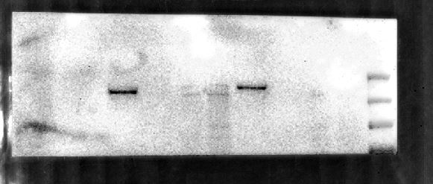
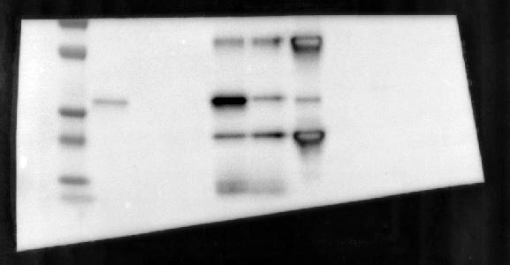
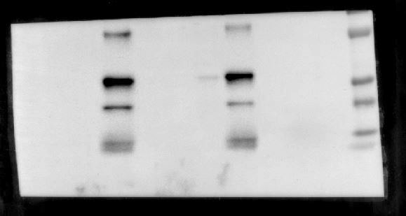
CDIN1^{3xFlag} HUDEP-2
150 mM NaCl
CDIN1^{3xFlag} HUDEP-2
IP:FLAG
250 mM NaCl
500 mM NaCl
Washes
Elution 1
Elution 2
Input
SN
Elution 3
Washes
IP:FLAG
Washes
IP:FLAG
Input
SN
Input
SN
250 kDa -
130 kDa -
- Codanin-1
100 kDa -
250 kDa -
- Codanin-1
α-Codanin-1
130 kDa -
IP:FLAG
100 kDa -
70 kDa -
α-Codanin-1
Washes
Elution 1
Elution 2
Input
SN
Elution 3
70 kDa -
55 kDa -
- Heavy Chain
70 kDa -
55 kDa -
- Heavy Chain
35 kDa -
- CDIN1-FLAG
- CDIN1-FLAG
25 kDa -
- Light Chain
35 kDa -
15 kDa -
25 kDa -
- Light Chain
10 kDa -
15 kDa -
α-FLAG
10 kDa -
α-FLAG

